Slide 1


Automating Azure: Infrastructure as Code in Azure
Shawn Weisfeld
Sr. Cloud Solution Architect
Microsoft

Slide 2

About Me
Shawn Weisfeld
Sr. Cloud Solution Architect
Microsoft – One Commercial Partner Technical Team
sweisfel@microsoft.com
Austin, TX
Get this PPT & Code Samples: https://bit.ly/2Mo3t9S

Slide 3

UserGroup.tv your source for FREE videos of technical community content online.
975+ hours of content donated by our local User Group speakers.
Check it out today @
http://www.UserGroup.tv

Slide 4


Slide 5
What is Infrastructure as Code (IaC)?
Management of deployed resources in a descriptive model, leveraging the same versioning techniques the developers use for source code.
Changes are made in the model and then the entire model is redeployed.
No manual configuration of environments
More Info: https://docs.microsoft.com/en-us/azure/devops/learn/what-is-infrastructure-as-code

Slide 6
Goals of IaC
Eliminate Environment Drift
Eliminate Inconsistency between Environments
Deployments are repeatable, automatable, and fully documented

Slide 7
Popular IaC Options in Azure
Azure Resource Management (ARM) Templates
Azure CLI/Posh Scripts
HashiCorp Terraform - https://www.terraform.io/
Chef - https://www.chef.io/
RedHat Ansible - https://www.ansible.com/
Puppet - https://puppet.com/

Slide 8


Slide 9
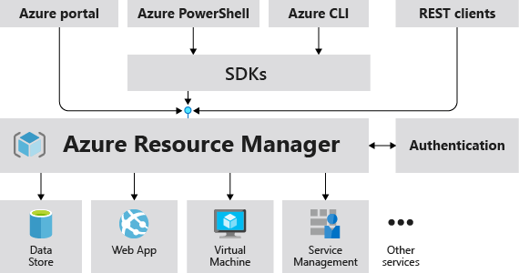
What is Azure Resource Management (ARM)?
Other Azure Resources
More Info: https://docs.microsoft.com/en-us/azure/azure-resource-manager/resource-group-overview

Slide 10
Vocab List
Resource – any item that can be managed in Azure (i.e. VM, storage, network, db, etc.)
Resource Group (RG) – a container used to group resources
Resource Provider – a service that supplies resources
ARM Template – Json doc that defines resources to deploy to a Resource group

Slide 11
Consider when Defining your RG’s
All the resources in your group should share the same lifecycle. You deploy, update, and delete them together.
Each resource can only exist in one resource group.
You can add or remove a resource to a resource group at any time.
You can move a resource from one resource group to another group.
A resource group can contain resources that are located in different regions.
A resource group can be used to scope access control for administrative actions.
A resource can interact with resources in other resource groups.

Slide 12
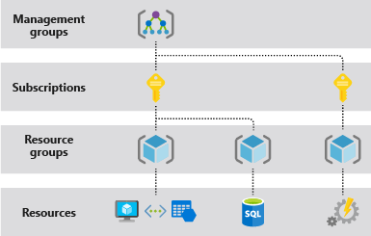
Scope in Azure

Slide 13



Azure Structure
Account and enterprise agreement
Subscription(s)
Resource group
Resource group
SQL
SQL
Role-based access control
Tags
Azure Resource Manager policy
Templates

Slide 14
RGs vs Tags
Resource groups
Tightly coupled to a container of resources
Follows RBAC rules
1 resource group at a time
Tags
Loosely coupled user or system defined categorization
Arbitrary boundaries
15 tags to use as needed
Resource groups and tags are the building blocks from which users define applications.

Slide 15
Access Control: RBAC
Allows secure access with granular permissions to resources
Assignable to users, groups or service principals or VMs
Built-in roles make it easy to get started

Slide 16
The Importance of Idempotence
A deployment always sets the target environment into the same configuration, regardless of the environment’s starting state.
Achieved by either:
Upgrading
ARM Templates
Destroy & Create
ARM Templates & Azure CLI/Posh

Slide 17
Procedural vs Declarative
PowerShell or Azure CLI
Sequential code calling commands to create the infrastructure.
ARM Templates
A JavaScript Object Notation (JSON) file that defines one or more resources to deploy to a resource group. It also defines the dependencies between the deployed resources. The template can be used to deploy the resources consistently and repeatedly.
declarative syntax - Syntax that lets you state "Here is what I intend to create" without having to write the sequence of programming commands to create it. The ARM template is an example of declarative syntax.

Slide 18
Demo:
Create a SQL Server with the CLI
More Info:
https://docs.microsoft.com/en-us/azure/sql-database/scripts/sql-database-create-and-configure-database-cli

Slide 19
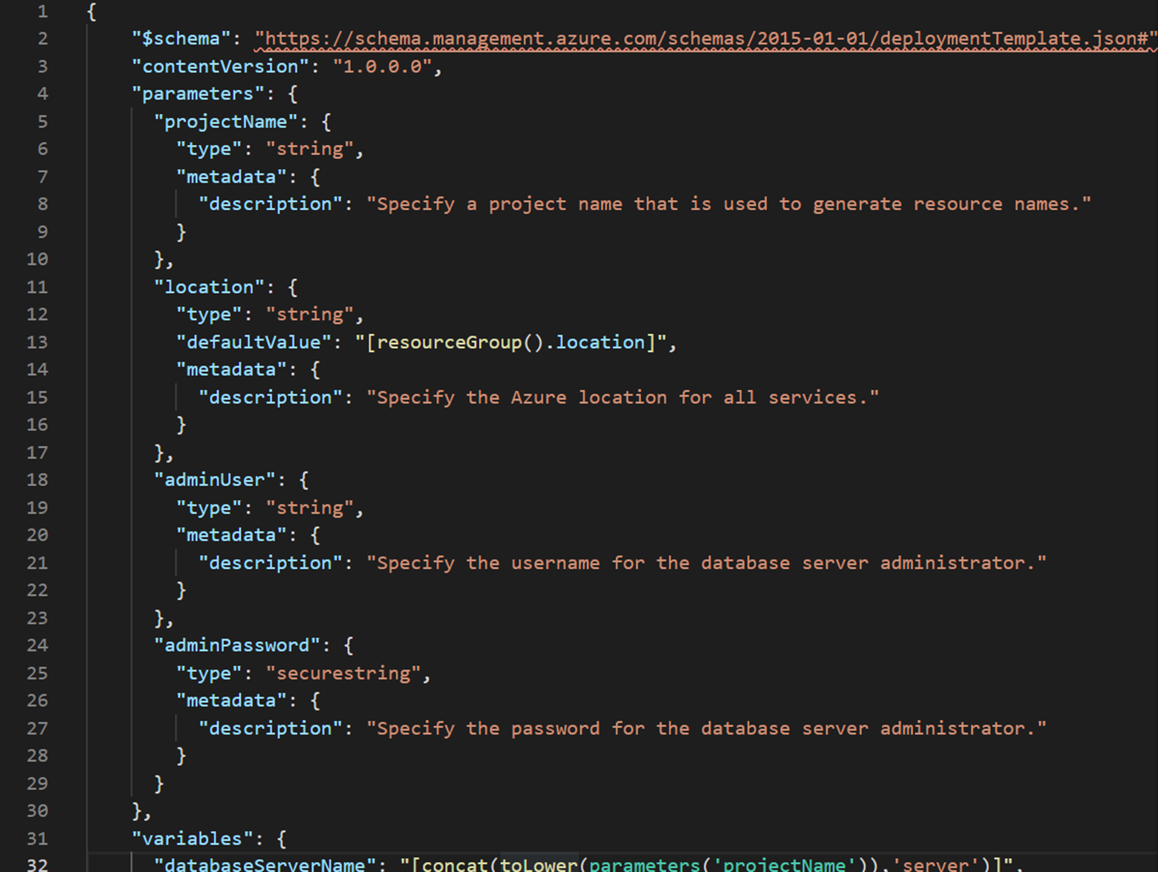
Demo:
Create a SQL Server with the ARM
More Info:
https://docs.microsoft.com/en-us/azure/sql-database/sql-database-single-database-get-started-template

Slide 20
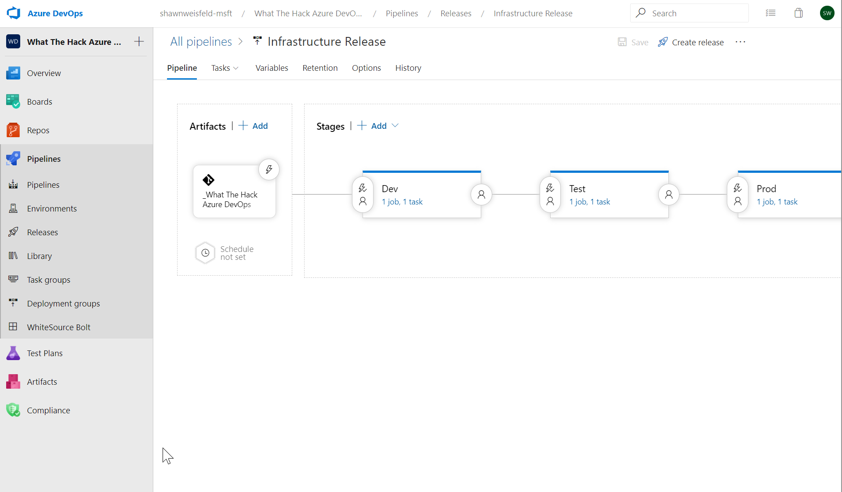
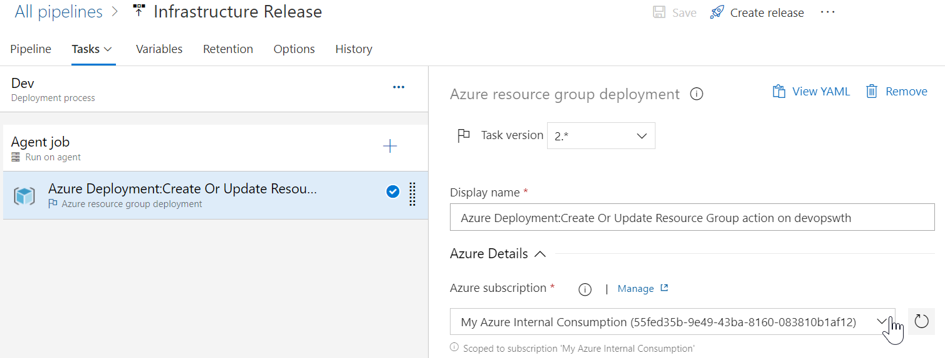
Demo:
Automate Template delivery with Azure DevOps

Slide 21
The template
Structure and elements
{
"$schema": "http://schema.management.azure.com/schemas/2015-01-01/deploymentTemplate.json#",
"contentVersion": "",
"parameters": { },
"variables": { },
"resources": [ ],
"outputs": { }
}
Declarative syntax
Allows you to declare the resources you want to have without having to write the script sequence of commands required to create it.

Slide 22
The template - Parameters
Minimize parameters
Too many parameters may confuse the user
Use the “metadata” to describe the parameter
This can help the user identify how and where the value will be used
Define default values
Setting default values guides user and reduces chances of invalid values
Parameters are mandatory, use default value to “make it optional”
Use securestring type
Passwords and secrets should use the securestring type

Slide 23
The template - Parameters

Slide 24
The template - Variables
Easier to read and edit
It can simplify your template, making it easier to read
Complex objects
Group variables into an object helps understand the template design
Custom values
Use expressions and functions to modify parameter values and construct new values

Slide 25
The template - Variables
"variables": {
"storageAccountName": "[concat(uniquestring(resourceGroup().id), 'sawinvm')]",
"nicName": "myVMNic",
"subnetRef": "[resourceId('Microsoft.Network/virtualNetworks/subnets', parameters('virtualNetworkName'), parameters('subnetName'))]",
"environmentSettings": {
"test": {
"instancesSize": "Small",
"instancesCount": 1
},
"prod": {
"instancesSize": "Large",
"instancesCount": 4
}
}
}

Slide 26
The template - Resources
Use “comments”
Use this tag to help others understand the purpose of the resource
ApiVersion
This property value will define the structure of the “properties” section of the resource
Hard-code it on the resource, so Visual Studio Intellisense can recognize it
Protected Settings
Use this property to pass secrets if the resource type supports it

Slide 27
The template - Resources
{ "type": "Microsoft.Storage/storageAccounts",
"name": "[variables('storageAccountName')]",
"apiVersion": "2016-01-01",
"location": "[resourceGroup().location]",
"sku": {
"name": "Standard_LRS"
},
"kind": "BlobStorage",
"properties": { "accessTier": "Hot" }
},
{ "type": "Microsoft.Storage/storageAccounts",
"name": "[parameters('storageAccountName')]",
"apiVersion": "2015-06-15",
"location": "[resourceGroup().location]",
"properties": {
"accountType": "Standard_LRS"
}
}

Slide 28
Deploying the template
Powershell
New-AzureRmResourceGroupDeployment -Name ExampleDeployment -ResourceGroupName ExampleResourceGroup -TemplateFile <PathToTemplate> -
Azure CLI
azure group deployment create -f "c:\MyTemplates\example.json" -g examplegroup
-n exampledeployment
REST API
PUT /subscriptions/{subscriptionId}/resourcegroups/{resourceGroupName}/providers/Microsoft.Resources/deployments/{deploymentName}?api-version=2016-09-01
az group deployment create -f "c:\MyTemplates\example.json" -g examplegroup
-n exampledeployment

Slide 29
Practices to avoid. . . ( !best practices )
Starting from scratch. . .
Leverage QuickStarts, Automation Script / Export, etc. to quickly get started
Over-parameterization (no defaultValues)
Use variables, functions/expressions, & intelligent defaults!
Duplicating code
Copy/Pasting and Nesting instead of using copy loops & functions/expressions
Variables for the sake of variables
“vmName” : “[parameters(‘vmName’)]”
Secrets in source
Use KeyVault and Managed Identity
Variables for api-version
New api-version represents an updated payload
Using the wrong template expression, wrong function or wrong approach (mul)
E.g. use resourceId() instead of concat()
Not using a template expression or wrong function
Unnecessary dependencies
Use dependsOn and/or reference() only when necessary
Hard-coding
URIs, Ips, secrets, locations, VM sizes, etc
RunOnce behaviors
Build idempotent, re-entrant templates
Thinking imperatively
ARM templates describe the goal state of an application, and the sequence in which that state can be realized
Notes:
NSG – Secure the app
User Choice – when it makes sense (location, SKU)
Use reference for endpoints

Slide 30
Advanced ARM Functions

Slide 31
Concat()…array and object function
Combines multiple arrays and returns the concatenated array, or combines multiple string values and returns the concatenated string
Concatenating multiple strings to create unique and dynamic names (in my opinion) is the most common and useful
“variables”: {
“vnetName”: “[concat(parameters(‘prefix’),’-VNET’)]”
…
}
https://docs.microsoft.com/en-us/azure/azure-resource-manager/resource-group-template-functions-array#concat

Slide 32
Condition()…comparison functions
Allows you to compare two values with functions such as equals, less, lessOrEquals, greater, greaterOrEquals
Combine “equals” with the “condition” element to test whether a resource is deployed (most useful example of comparison functions that I’ve found yet)
{
“condition”: “[equals(variables(‘newOrExisting’),’new’]”
…
}
https://docs.microsoft.com/en-us/azure/azure-resource-manager/resource-group-template-functions-comparison

Slide 33
toLower()…string function
Useful collection string manipulation functions
How useful depends on your needs and approach to ARM templates
toLower() useful to help ensure proper formatting
"variables":{
"prefix": "NBTL062017"
},
…
"name": "[concat('storagev', toLower(variables('prefix'))]",
https://docs.microsoft.com/en-us/azure/azure-resource-manager/resource-group-template-functions-string

Slide 34
ResourceID property
Unique identifier of a resource in Azure
Used to reference one resource as a parameter in another resource.
Example: A virtual machine needs to specify the resourceID of the NIC that it is attached to
Example: A NIC needs to specify the resourceID of the vnet+subnet that it is attached to. (Often, the Vnet will be deployed in a separate resource group!)
Example: A Vnet can specify the resourceID of a NSG that is applied to it.
A fully qualified ResourceID is a concatenation of:
<subscriptionID>/<resourceGroupName>/<resourceType>/<resourceName>
Example: “acc9711d-c67e-47b0-bba3-9f6561a68511/myResourceGroup/Microsoft.Network/networkSecurityGroups/myNSG”
ResourceID can be inferred from name & type if it’s unique within scope
Example: “<resourceType>/<resourceName>”
“Microsoft.Network/networkSecurityGroups/myNSG”
This works as long as there’s a NSG called “myNSG” in the current resource group.
If I’m looking for “myNSG” in some other resource group or subscription, then this won’t work!

Slide 35
resourceId()…resource function
resourceId() is seen often in auto generated templates and some from the Git repo
Returns the unique identifier of a resource which is useful when the resource name is ambiguous or not provisioned with the same template
Often used to reference storage accounts or virtual networks in an alternate resource group
"variables": {
"vnetID": "[resourceId(parameters('virtualNetworkResourceGroup'), 'Microsoft.Network/virtualNetworks', parameters('virtualNetworkName'))]",
"subnet1Ref": "[concat(variables('vnetID'),'/subnets/', parameters('subnet1Name'))]"
}
https://docs.microsoft.com/en-us/azure/azure-resource-manager/resource-group-template-functions-resource

Slide 36
Linked/Nested Templates
Useful for “separation of duties” (e.g. network team responsible for network templates, etc)
Linked templates cannot be local.
Linked templates must be ‘staged’ at an http endpoint for the Azure Resource Manager to access them.
Use a storage account or git repo for staging
You can pass parameters directly to the linked template as you would the parent template
{
"type": "Microsoft.Resources/deployments",
…
}
https://docs.microsoft.com/en-us/azure/azure-resource-manager/resource-group-template-functions-deployment

Slide 37
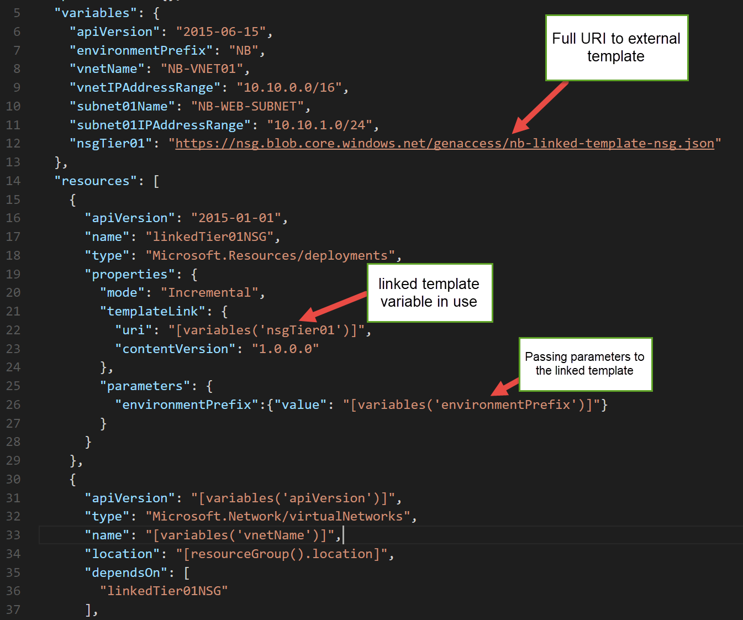
Example

Slide 38
Resources

Slide 39
Helpful ARM docs
Azure Docs
https://docs.microsoft.com/en-us/azure/azure-resource-manager/resource-group-authoring-templates
Azure Learning Path - Administer infrastructure resources in Azure
https://docs.microsoft.com/en-us/learn/paths/administer-infrastructure-resources-in-azure/

Slide 40
Tools to help you build ARM templates
Extensions for VS Code
ARM Tools
ARM Snippets

Slide 41
Sample ARM
Resources.azure.com
Export an ARM Template from the portal
Azure Quickstart Templates
https://azure.microsoft.com/en-us/resources/templates/

Slide 42
Thank you!
Shawn Weisfeld
Sr. Cloud Solution Architect
Microsoft – One Commercial Partner Technical Team
sweisfel@microsoft.com
Austin, TX
Get this PPT & Code Samples: https://bit.ly/2Mo3t9S

